Slide 1
Module 6

Slide 2
Standard Library functions
Refer : Text Books, Lab Assignment 6.

Slide 3
Unix system Interface

Slide 4
File Descriptors
A file descriptor is a number that uniquely identifies an open file in a computer's operating system. It describes a data resource, and how that resource may be accessed.
When a program asks to open a file — or another data resource, like a network socket — the kernel:
Grants access.
Creates an entry in the global file table.
Provides the software with the location of that entry.
The descriptor is identified by a unique non-negative integer
Name | File descriptor | Description | Abbreviation
Standard input | 0 | The default data stream for input, for example in a command pipeline. In the terminal, this defaults to keyboard input from the user. | stdin
Standard output | 1 | The default data stream for output, for example when a command prints text. In the terminal, this defaults to the user's screen. | stdout
Standard error | 2 | The default data stream for output that relates to an error occurring. In the terminal, this defaults to the user's screen. | stderr

Slide 5
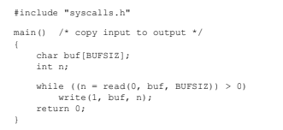
Read and Write
Int n_read = read(int fd, char *buf, int n)
Int n-written=write(int fd, char *buf, int n)

Slide 6
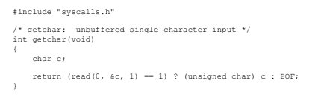
getchar()

Slide 7


open()

Slide 8

create()

Slide 9
Text Book
Brian W. Kernighan and Dennis Ritchie, “The C Programming Language”, Pearson Education India; 2nd Edition. ISBN: 978-9332549449. 2015.

